Slide 1

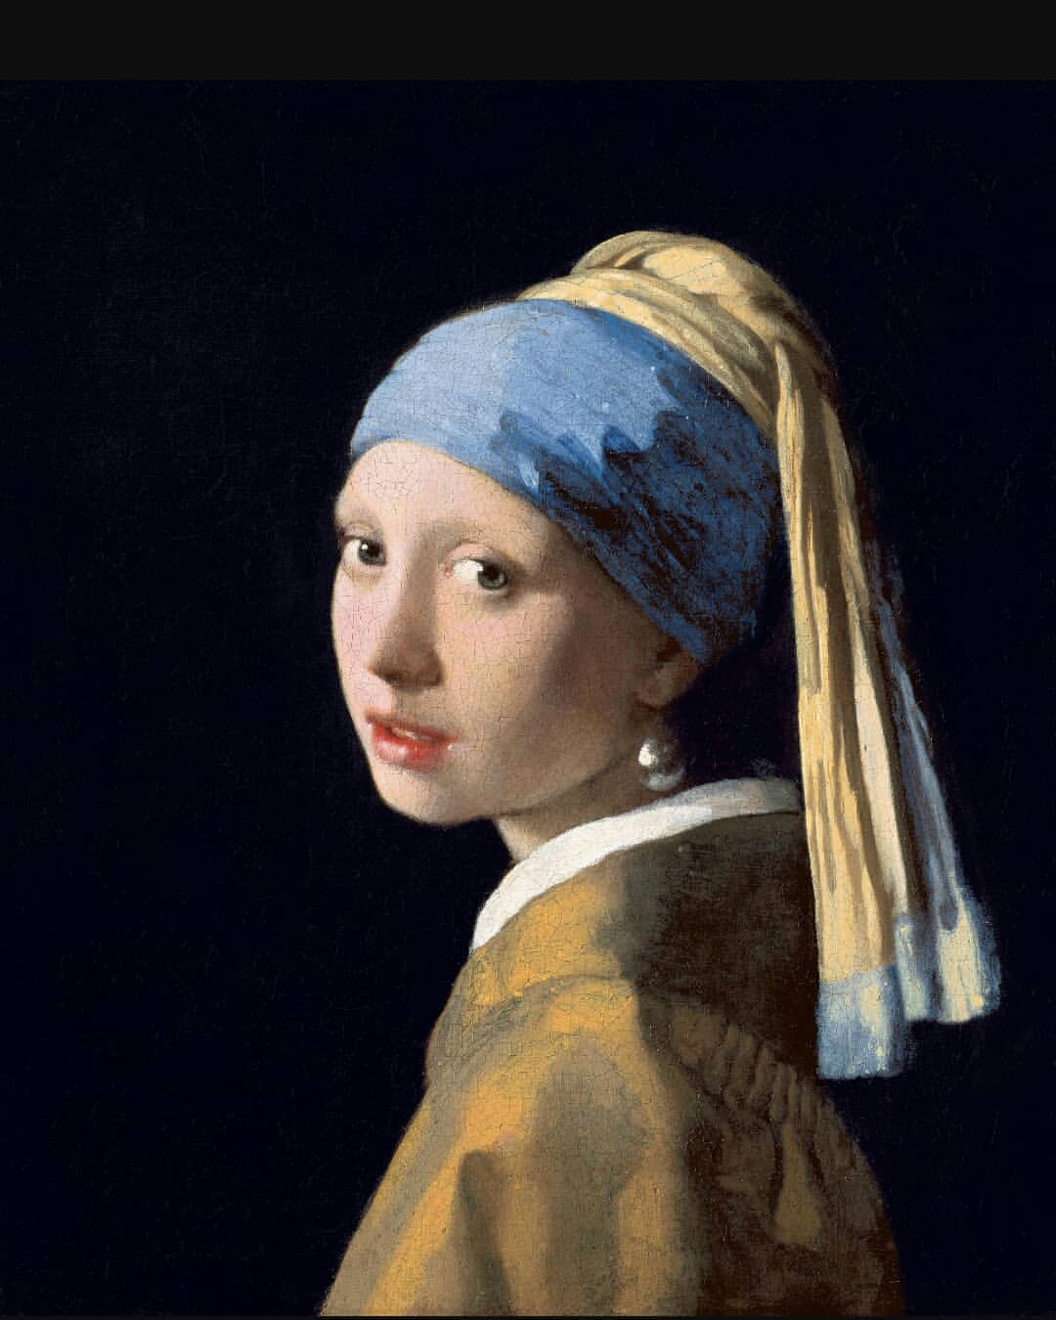
Painting, Movies, and Emotions
Computer Vision: Supervised Deep Learning
Notes:
Hello! Thank you for the opportunity to talk about Paintings, Movies, and Emotions in the context of Computer Vision////
Art is a human creation that is meant to be appreciated, make people think, and evoke an emotional response, whether positive, negative, or a mixt of emotions….. // They say THAT life imitates art...

Slide 2

Movie scenes influenced by paintings
Notes:
Now, let’s observe... movie scenes... influenced by paintings.

Slide 3
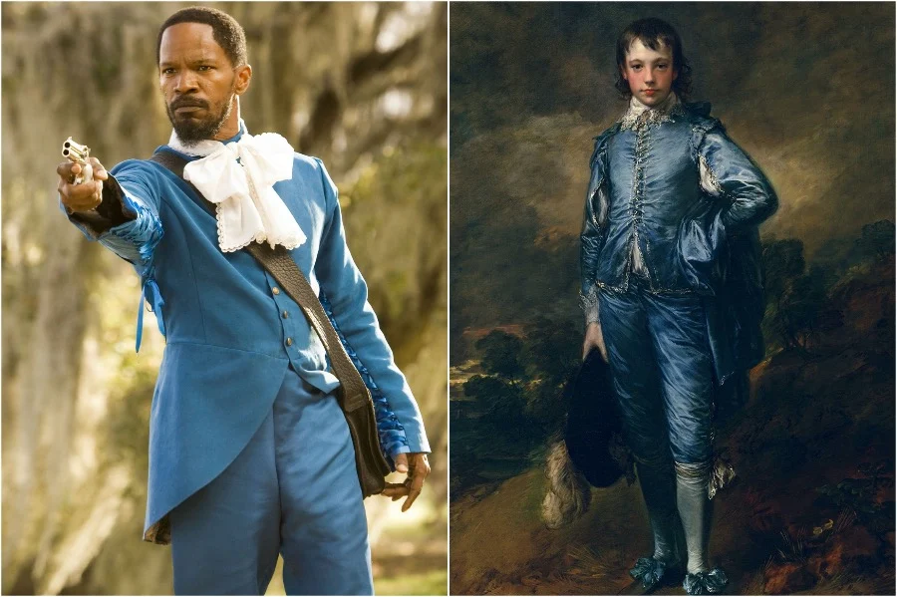
Django Unchained
(2012)
by Tarantino
The Blue Boy
(1770)
by Thomas Gainsborough
Notes:
Here we can see how this scene from Django Unchained was inspired by the rocOco painting The Blue Boy.

Slide 4
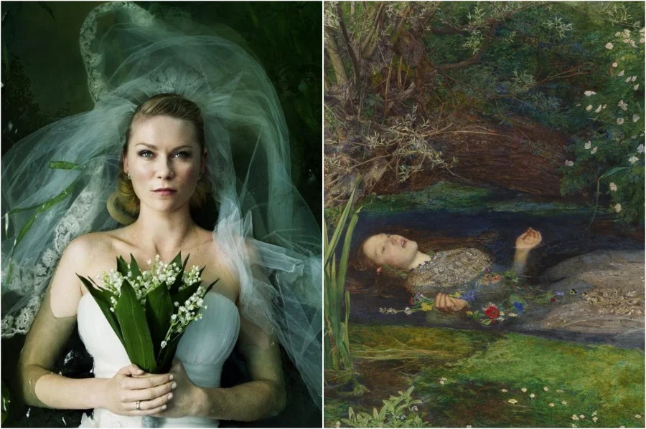
Melancholia
(2011)
by Lars Von Trier
Ophelia
(1851-1852)
by John Everett Millais
Notes:
This one from mElancholia inspired by Ophelia.

Slide 5
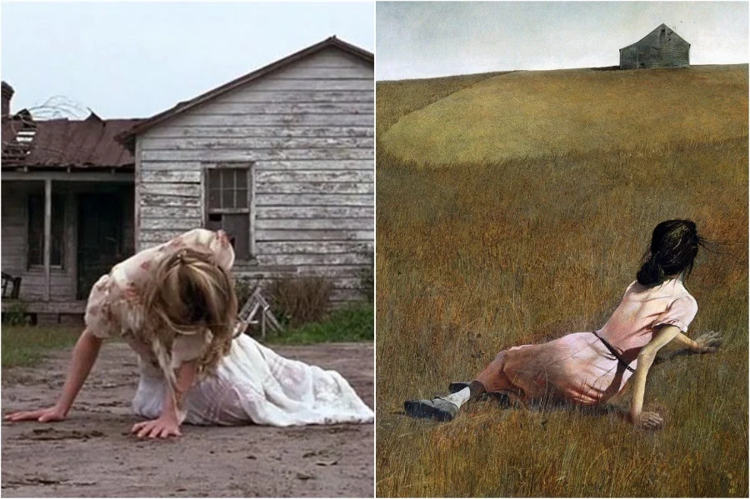
Forrest Gump
(1994)
by Robert Zemeckis
Christina’s World
(1851-1852)
by John Everett Millais
Notes:
A Forrest Gump scene recreating the painting Christina's world.

Slide 6

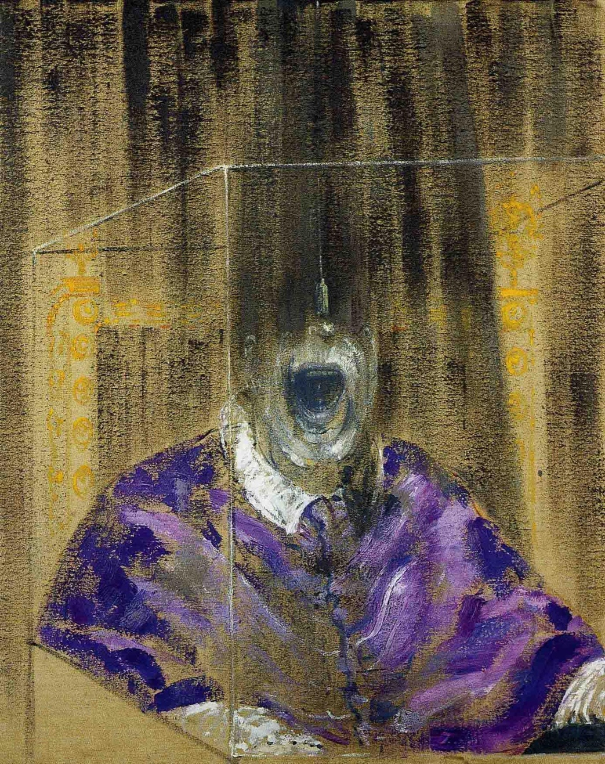
Head VI
(1949)
by Francis Bacon
Joker
(2019)
by Todd Phillips
Notes:
The Joker inspired by Head Six

Slide 7
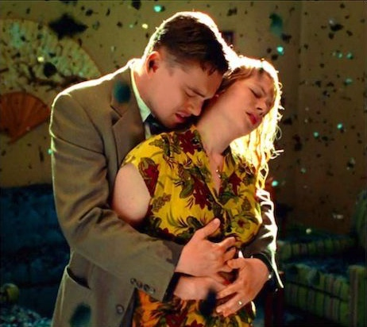
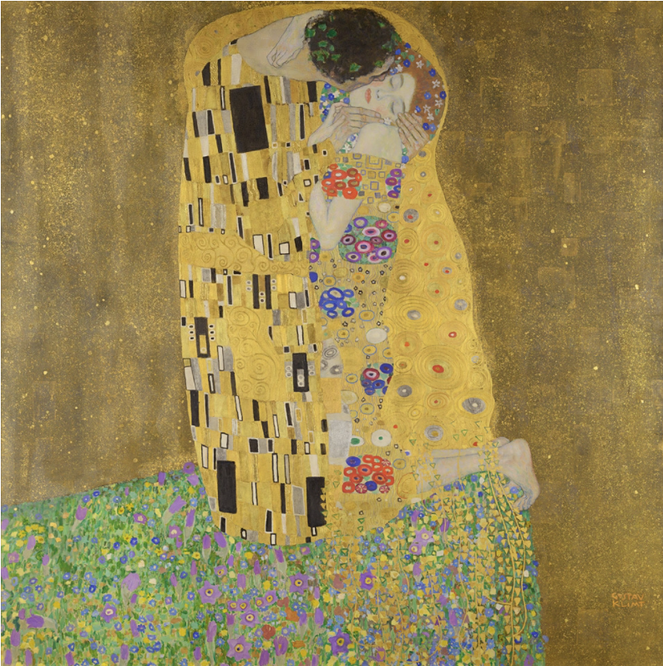
Shutter Island
(2010)
by Martin Scorsese
The Kiss
(1908)
by Gustav Klimt
Notes:
The movie Shutter Island and the painting The Kiss

Slide 8
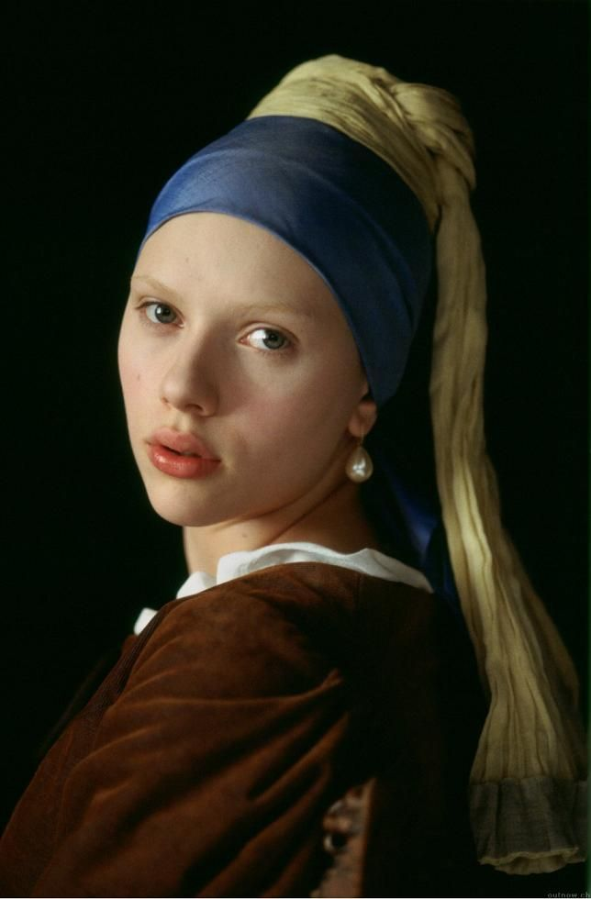
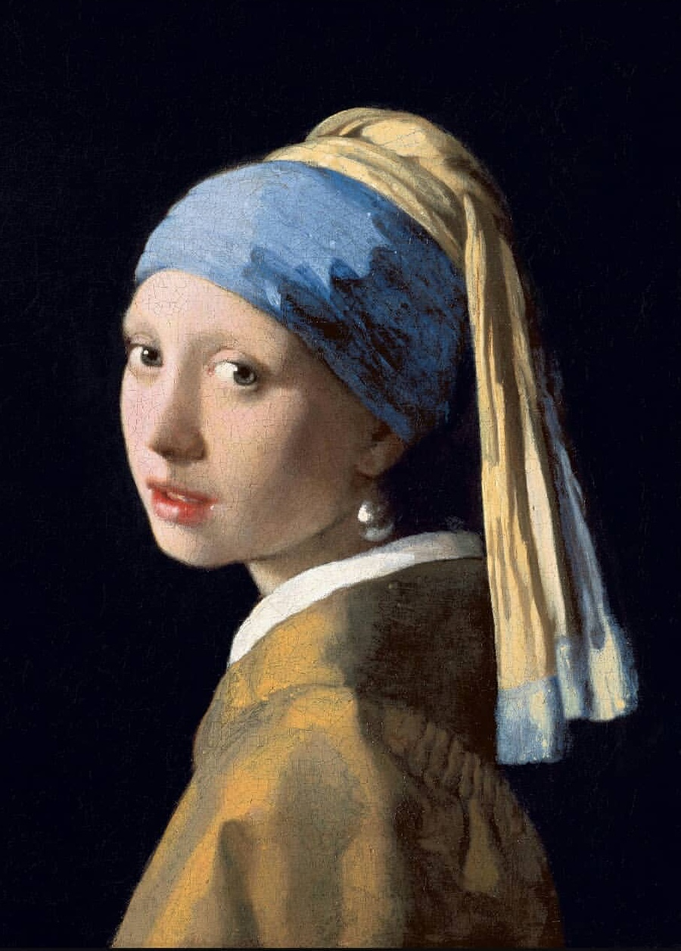
Girl with a Pearl Earring
(1665)
by Johannes Vermeer
Girl with a Pearl Earring
(2003)
by Peter Webber
Notes:
And a more obvious example: Girl with a Pearl Earring inspired by Girl with a Pearl Earring.

Slide 9
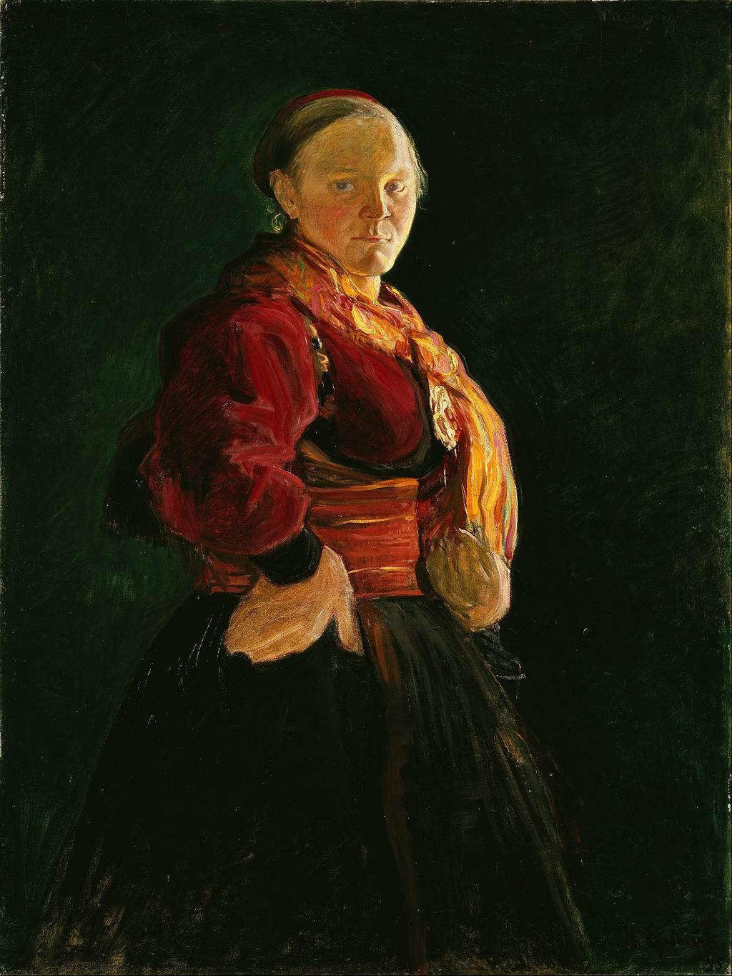

Goals
Train a neural network to classify paintings by the emotion evoked in the observer.
Test the neural network with the classification of unlabeled movie scenes.
1
2
Notes:
That being said, we have two goals with this project: First) To Train a neural network to classify paintings by the emotion evoked in the observer.

Slide 10
Goals
Train a neural network to classify paintings by the emotion evoked in the observer.
To explore if the neural network can classify unlabeled movie scene images by emotion.
1
2
Notes:
And Second) To explore whether the neural network can classify of unlabeled movie scene images by emotion.

Slide 11
Methodology
Notes:
Let’s talk about the methodology

Slide 12
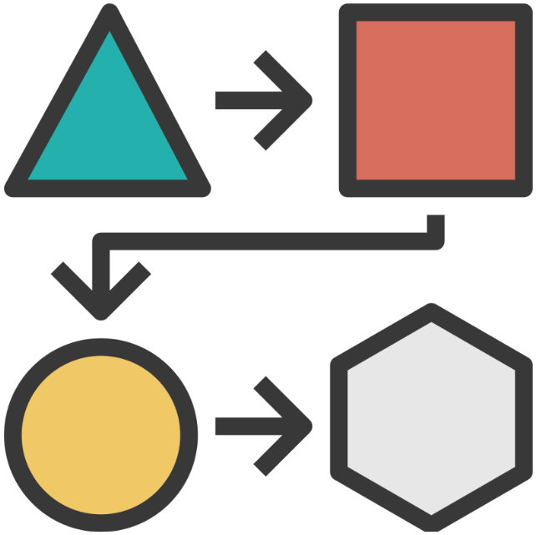
Methodology
Dataset: WikiArt Emotions
4,105 paintings
Annotated for emotions evoked in the observer.
Annotated via crowdsourcing for one or more of twenty emotions.
Data
http://saifmohammad.com/WebPages/wikiartemotions.html
Notes:
I used the dataset WikiArt Emotions, created by researchers at the National Research Council of Canada. This dataset contains arround four thousand pieces of art annotated for up to 20 emotions evoked in the observer.

Slide 13
Methodology
Convolutional Neural Network
Transfer-learning with ResNet-101
Data Augmentation
Adam optimizer
Design
Data
Notes:
I used a convolutional neural network, based on transfer learning with ResNet-101, used Adam optimizer, and added Data Augmentation.

Slide 14
Methodology
Pytorch
imgaug
OpenCV
Google Colab GPU
Design
Data
Tools
Notes:
I worked with the Pytorch Library, and for data augmentation, the libraries IMGaug and OpenCV. And I used the Google Colab GPU.

Slide 15
Methodology
Train/Test Split
Design
Data
Tools
Evaluation
Notes:
For evaluation... the 80-20 train/test split ….

Slide 16
Methodology
Train/Test Split
Softmax activation
Design
Data
Tools
Evaluation
Notes:
Softmax activation for three classes.

Slide 17
Methodology
Train/Test Split
Softmax activation
F1 score
Categorical Crosscentropy Loss
Design
Data
Tools
Evaluation
Notes:
My metrics where the F1 score and the Categorical Crosscentropy Loss

Slide 18
Methodology
Train/Test Split
Softmax activation
F1 score
Categorical Crosscentropy Loss
Confusion Matrix
Design
Data
Tools
Evaluation
Notes:
I also evaluated with confusion matrix

Slide 19
Emotions
arrogance
disgust
fear
pessimism
regret
sadness
shame
disagreeableness
anticipation
shyness
surprise
neutral
anger
gratitude
happiness
humility
love
optimism
trust
agreeableness
Notes:
In the data, each painting had annotations for multiple emotions evoked in the observer, for up to 20 emotions per painting. Then, the scores for indivudual emotions were aggregated to create three additional scores….One for positive, one for negative and one for mixt.

Slide 20



Labels
Positive
gratitude, happiness, humility, love, optimism, trust
Mixt
agreeableness, disagreeableness, anticipation, shyness, surprise, neutral
Negative
anger, arrogance, disgust, fear, pessimism, regret, sadness, shame
Notes:
Each painting received a score for positive, negative, and mixt, and the sentiment with the higher score was assigned to the painting as the label.

Slide 21
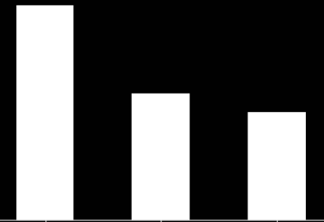
Sentiment Distribution
1,963
1,159
983
Positive
Mixt
Negative
Notes:
The data was imbalanced: the majority class was the positive sentiment and the minority… the negative sentiment. This makes sense, as Paintings tend to evoke positive emotions more frequently than negative emotions in the observer.

Slide 22
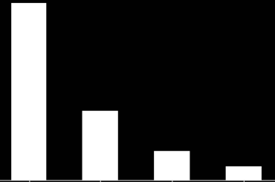
Distribution of Sentiments
Distribution of Painting Styles
1,963
Modern Art
2502
1,159
983
Post Renaissance Art
988
Renaissance Art
415
Positive
Mixt
Negative
Contemporary Art
200
Notes:
The majority of the paintings belonged to Modern Art, followed by Post Renaissance art.

Slide 23
Results
Notes:
Now, let’s see our results.

Slide 24
Results
 | F1 | Precision | Recall
Negative | 0.46 | 0.46 | 0.46
Mixt | 0.65 | 0.68 | 0.63
Positive | 0.73 | 0.72 | 0.75
Notes:
As expected, the model does a better job classifying the positive class, followed by the mixt….

Slide 25
Results
 | F1 | Precision | Recall
Negative | 0.46 | 0.46 | 0.46
Mixt | 0.65 | 0.68 | 0.63
Positive | 0.73 | 0.72 | 0.75
Notes:
It does not do a good job classifying the negative class.

Slide 26
Results
Negative
Mixt
Positive
93 | 31 | 79
48 | 146 | 38
58 | 38 | 290
Negative
Mixt
Positive
Notes:
The confusion matrix reflects that although the classes Mixt and Positive where better classified….

Slide 27
Results
Negative
Mixt
Positive
93 | 31 | 79
48 | 146 | 38
58 | 38 | 290
Negative
Mixt
Positive
Notes:
40% of the negative class was classified as positive…..

Slide 28
Misclassification Pattern
Paintings with human faces or bodies tend to be classified as positive even if they are not.
Notes:
We found a couple of missclassification patterns. One of them is that paintings with human faces or bodies tend to be classified as positive even if they are not.

Slide 29
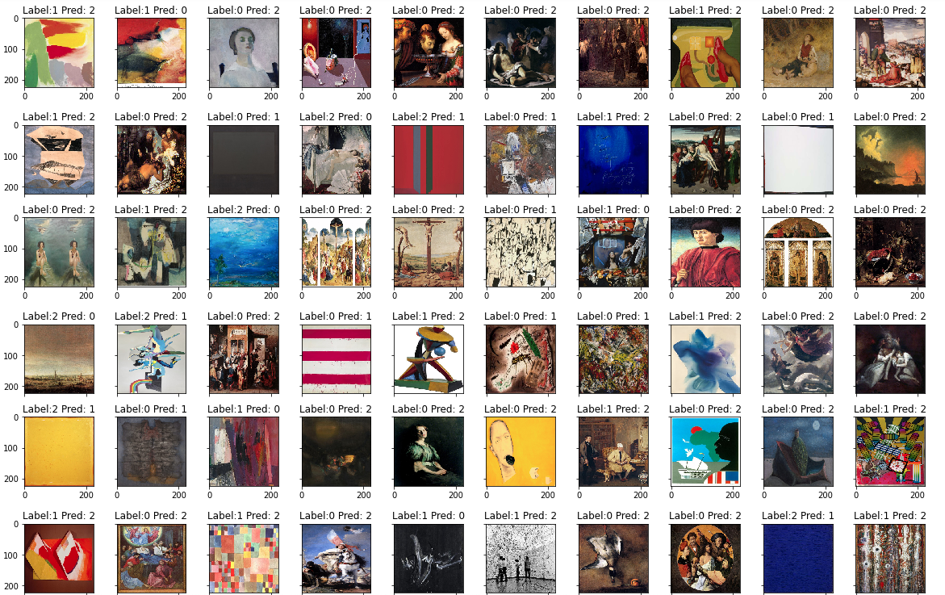
Incorrectly Classified
Notes:
Here we have a sample of paintings that were incorrectly classified. We can identify the pattern very clearly.

Slide 30
Incorrectly Classified
Notes:
We are seeing images originally labeled as negative (or zero), and predicted as positive (or two). We see that these are paintings with the human face or body.

Slide 31
Incorrectly Classified
Notes:
Here are more examples

Slide 32
Incorrectly Classified
Notes:
We can see that even though some images are clearly negative, the model is biased, assigning positive (or 2) to human faces and bodies.

Slide 33
Incorrectly Classified
Notes:
Here are more examples

Slide 34
Incorrectly Classified
Notes:
And we observe the same in the last line.

Slide 35
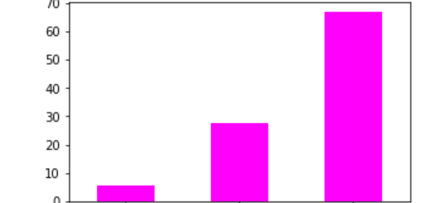
But why is this?
Face by Sentiment
mixt negative positive
Notes:
The data is biased because the majority of the paintings with faces are actually labeled as positive.

Slide 36
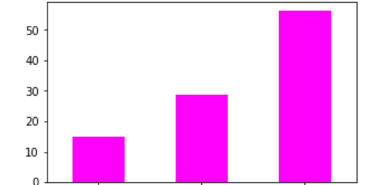
But why is this?
Face by Sentiment
Body by Sentiment
mixt negative positive
mixt negative positive
Notes:
The same happens with paintings with the human body.

Slide 37
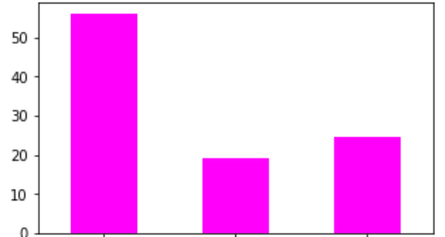
But why is this?
Face by Sentiment
Body by Sentiment
None by Sentiment
mixt negative positive
mixt negative positive
mixt negative positive
Notes:
To the contrary, the majority of paintings with no face or human body were labeled as mixt.

Slide 38
Correctly Classified
Notes:
Now let’s see samples of paintings correctly classified.

Slide 39
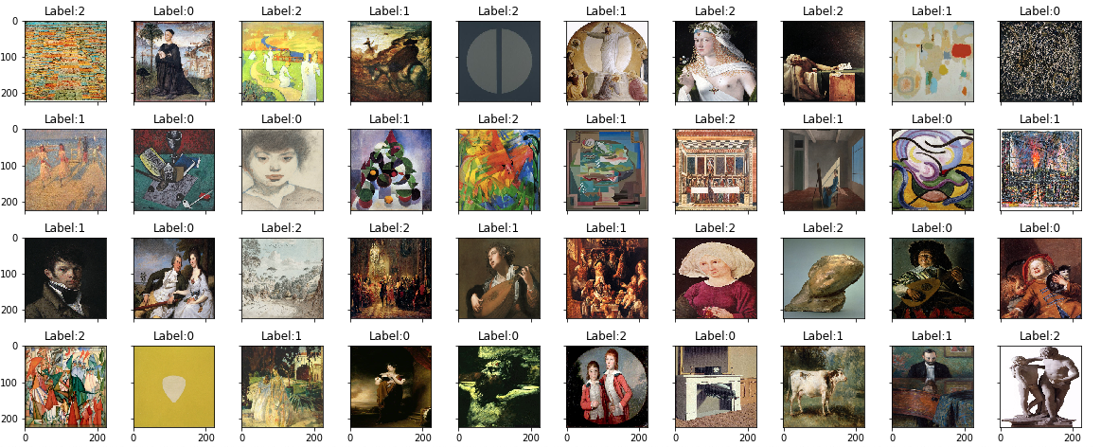
Correctly Classified
Notes:
Here we have an overview.

Slide 40
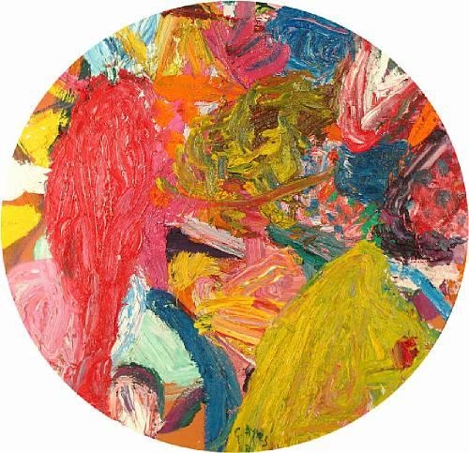
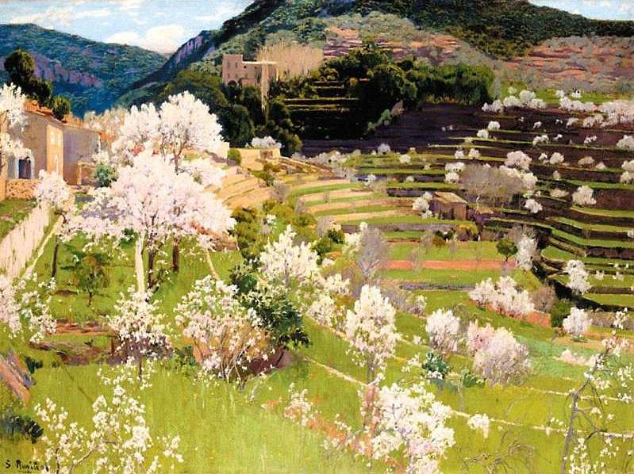
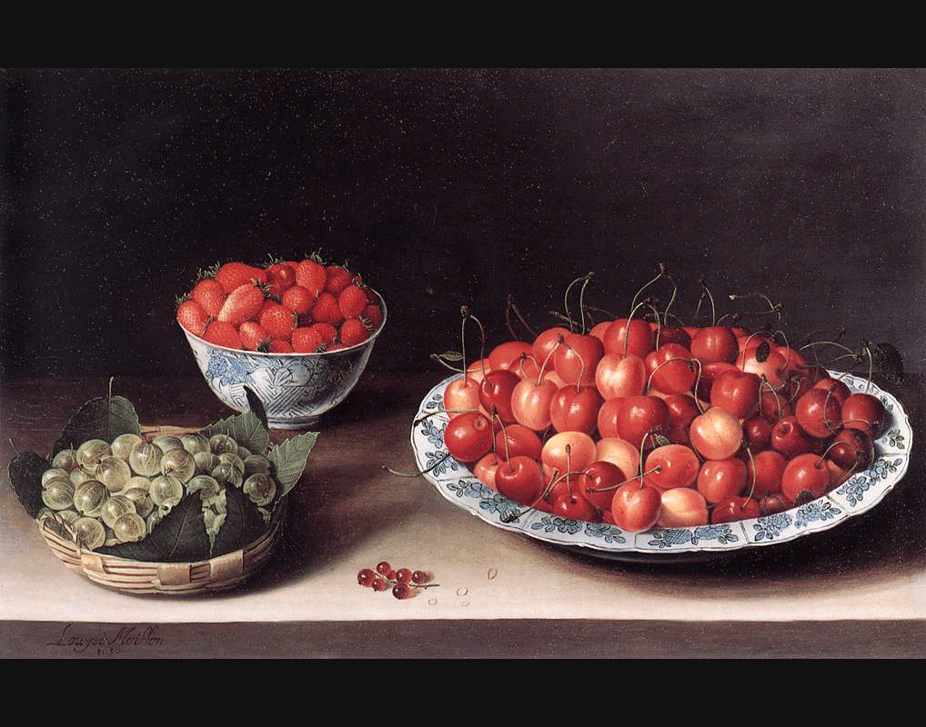
Correctly Classified as Positive
Notes:
And in more detail… correctly classified as positive.

Slide 41
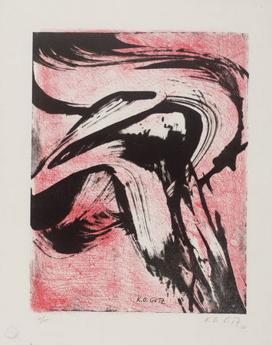
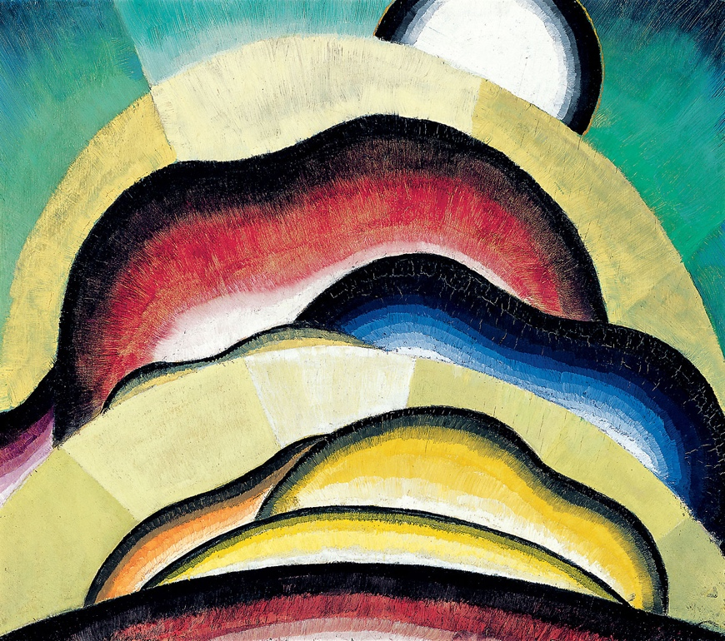
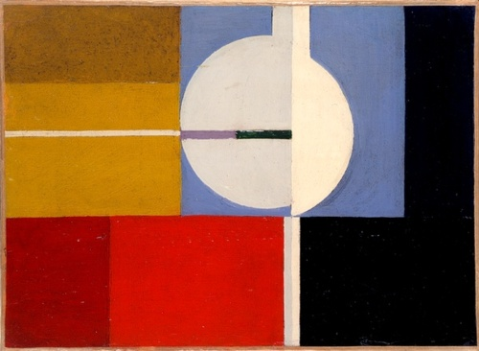
Correctly Classified as Mixt
Notes:
As mixt….

Slide 42
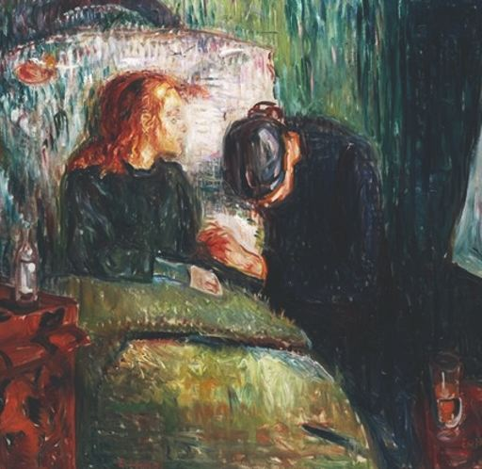
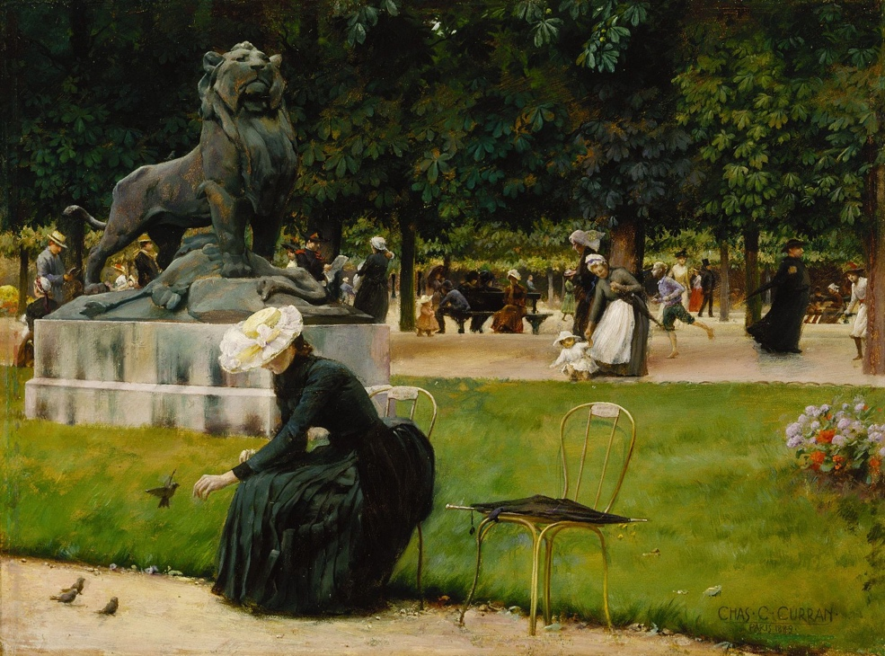
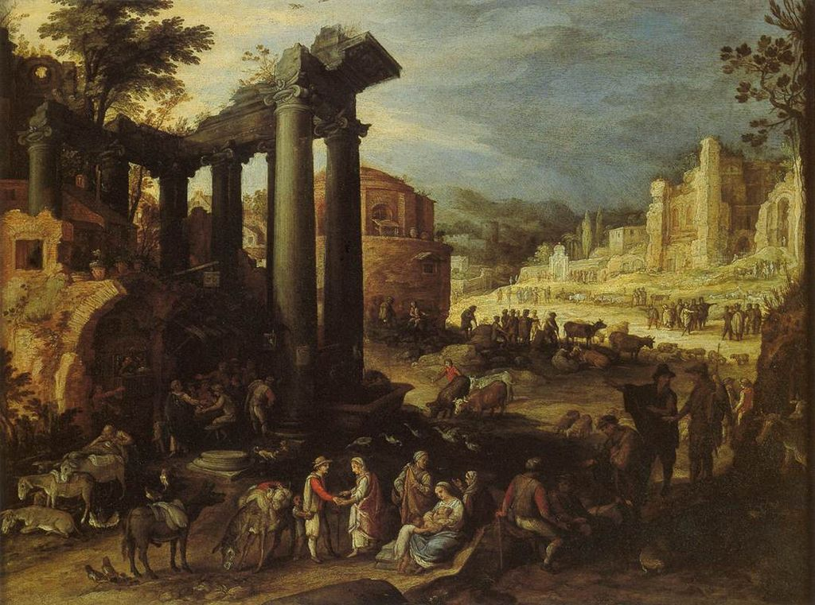
Correctly Classified as Negative
Notes:
And as negative….

Slide 43
Experiment with Movie Scenes
Notes:
As or second goal was to test the model with movie scene images. We past 20 movie scene images to the model. As expected, the majority were classified as positive. Which shows that the model needs to be trained with more data for the negative and mixt classes. Let’s see examples of the classifications.

Slide 44
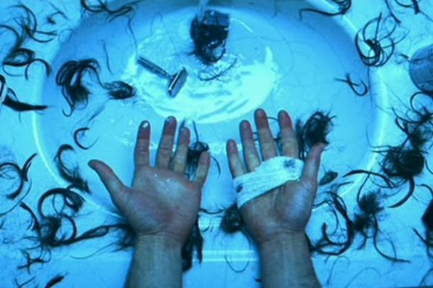
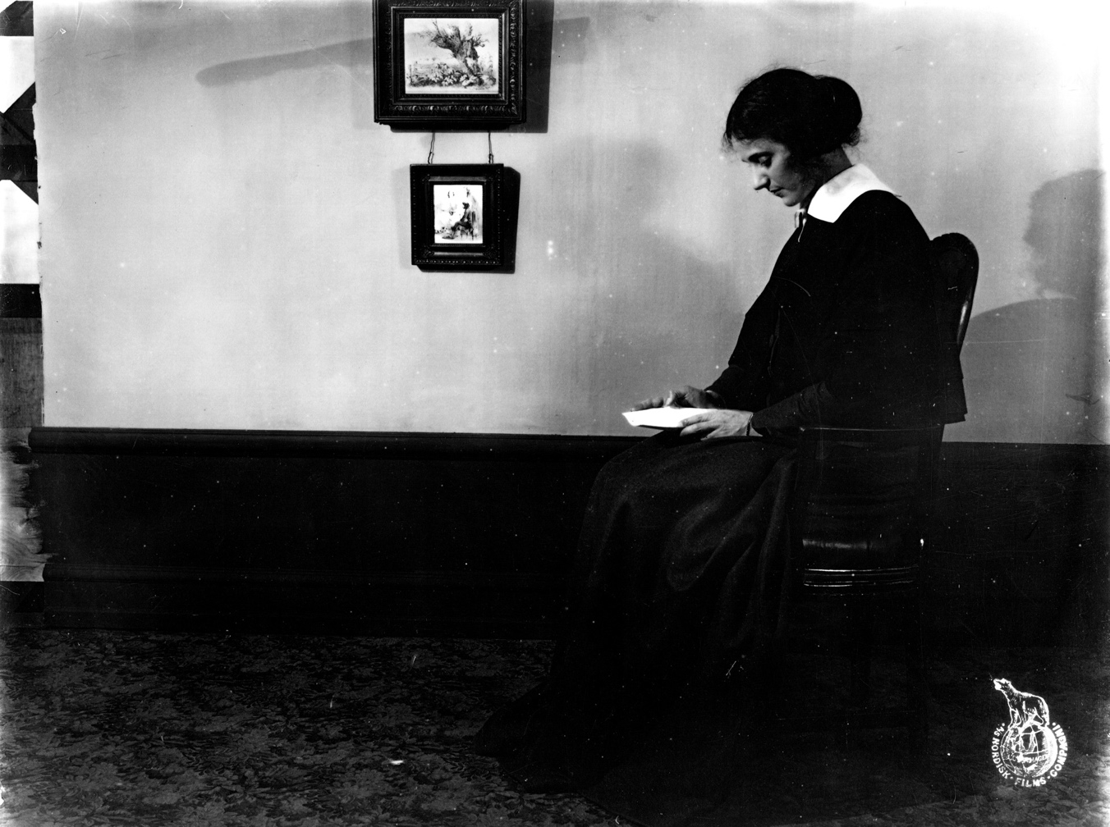
Movie scenes classified as negative
Notes:
These two were classified as negative.

Slide 45
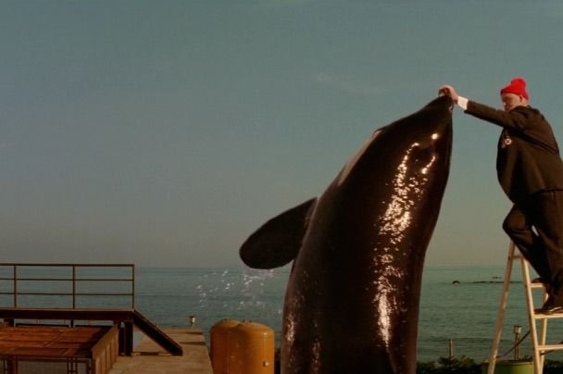
Movie scene classified as mixt
Notes:
This was the only one classified as mixt.

Slide 46
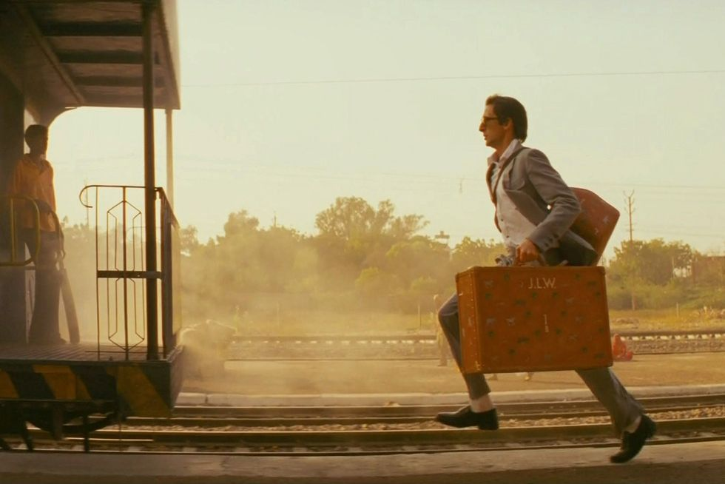
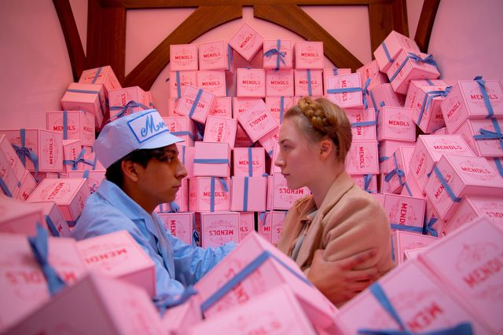
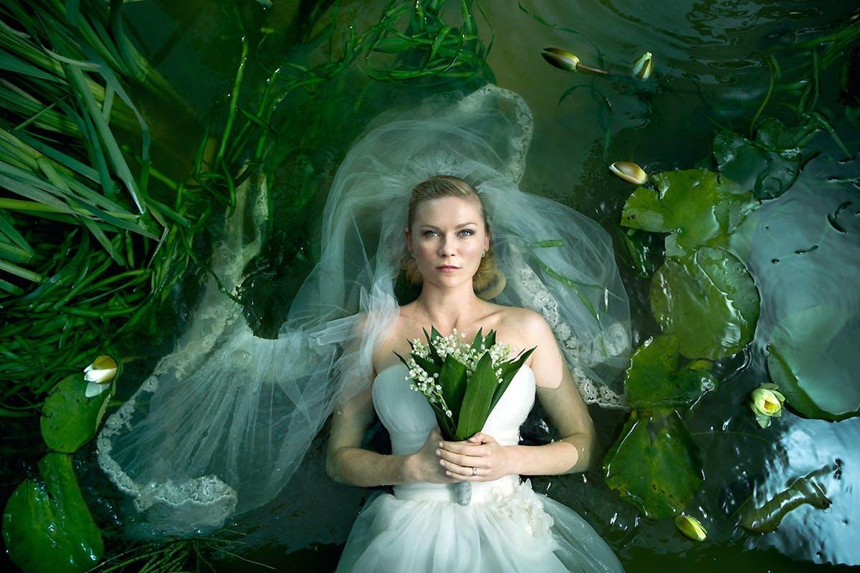
Movie scenes classified as positive
Notes:
These three were classified as positive. We need to test the model with a larger set of movie images.

Slide 47
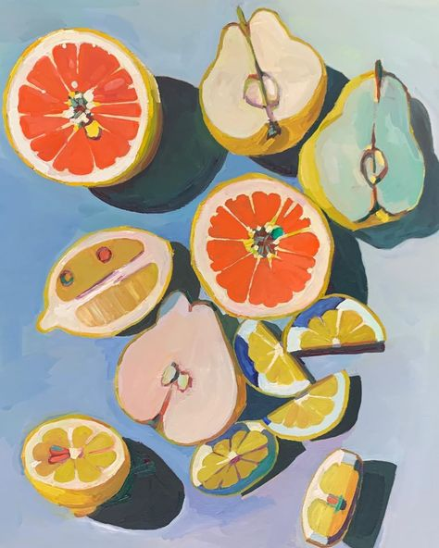
Conclusions
Paintings with human faces and bodies tend to be classified as positive.
Notes:
To conclude: for this dataset, paintings with human faces and bodies tended to be classified as positive.

Slide 48
Conclusions
Paintings with human faces and bodies tend to be classified as positive.
Abstract art tend to be classified as mixt.
Notes:
Abstract art tended to be classified as mixt, although we did not have time to talk about that misclassification pattern.

Slide 49
Takeaway
A neural network trained to classify movies by the emotion evoked in the observer might be useful to classify movie scenes by emotions evoked in the observer.
Notes:
As a take away we can say that A neural network trained to classify paintings by the emotion evoked in the observer might be useful to classify movie scenes by the same target. Further experimentation is needed.

Slide 50
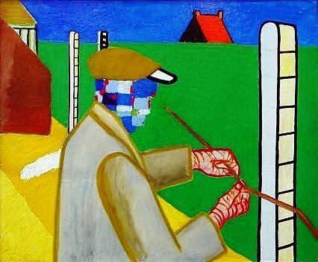
Future Work
Trained model with larger and balanced dataset.
Notes:
For future work: I need to train the model with a larger and balanced dataset.

Slide 51
Future Work
Trained model with larger and balanced dataset.
Test the model with a larger dataset of movie scene images
Notes:
Test the model with a larger dataset of movie scene images.

Slide 52
Future Work
Trained model with larger and balanced dataset.
Test the model with a larger dataset of movie scene images
Implement multilabel classification for the 20 emotions.
Notes:
And experiment with multilabel classification for the 20 emotions.

Slide 53
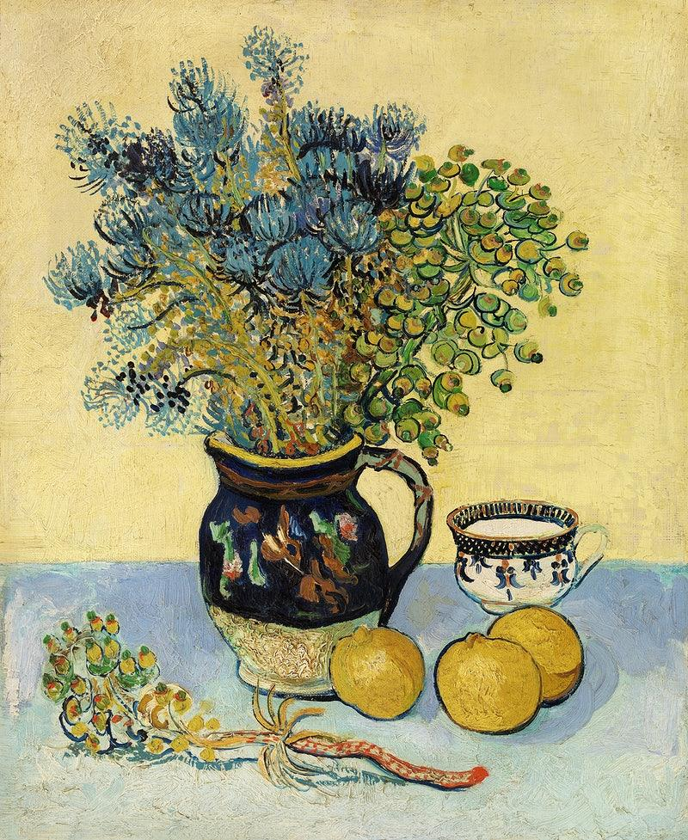



Thank You!
Laura Urdapilleta
laura.urdapilleta@gmail.com
https://www.linkedin.com/in/laura-m-urdapilleta/
https://github.com/Laura-Urdapilleta
Notes:
Thank You, and I'm open for questions.

Slide 54
Appendix

Slide 55
